Slide 1
Innovation in augmented listening technology hardware demo
Juan Martinez-Villalba

Slide 2
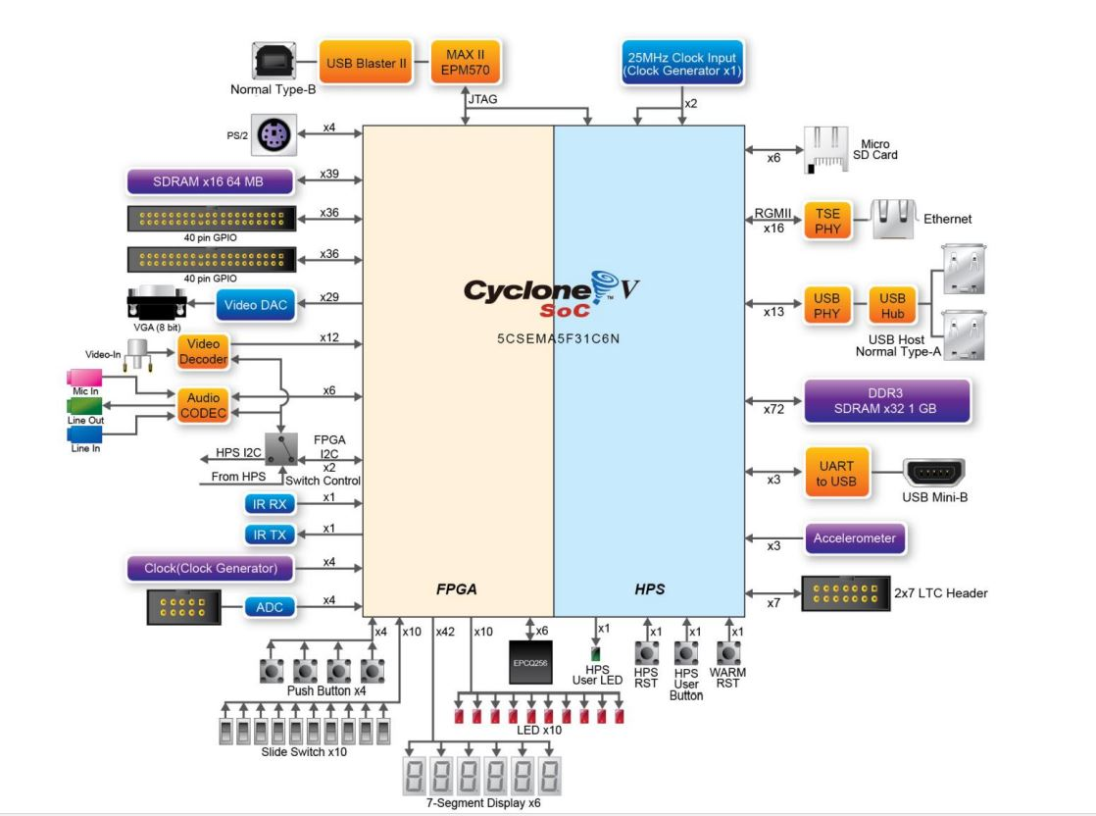
Altera’s de1-Soc
FPGA with ARM-9 HPS
64 MB SDRAM and 1GB DDR3 SDRAM
2 X 40 GPIO Headers
WM8731 CODEC

Slide 3
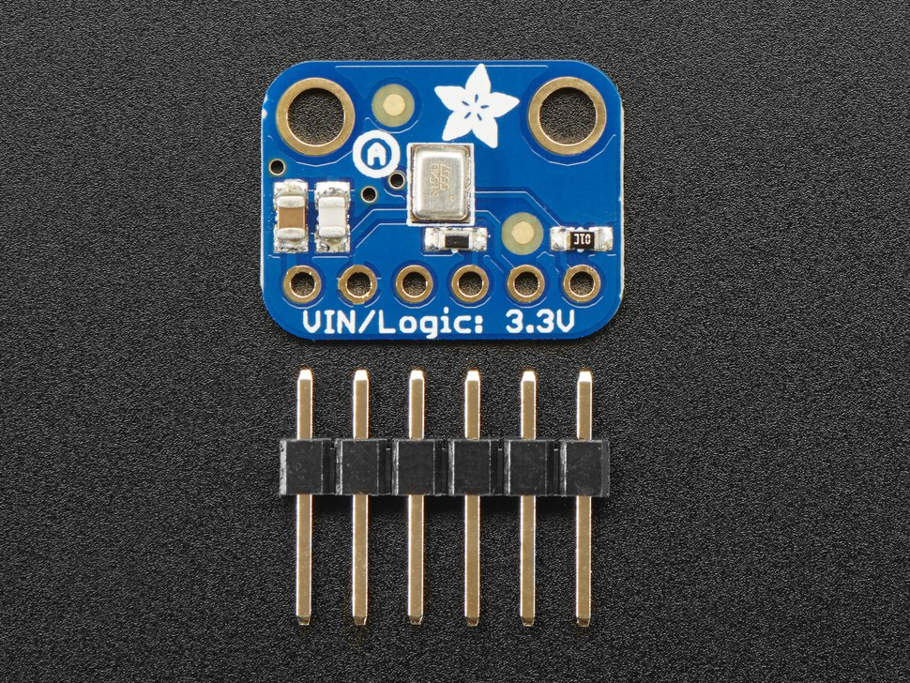
Audio acquisition
Array of 10 Adafruit I2S mems microphone
16 bits resolution
Sampled at 48 kHz
Each pair of microphones share data line
All microphones share the same clock
Connected to GPIO headers

Slide 4
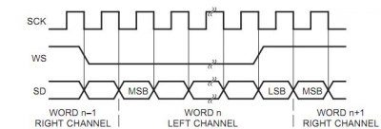
Audio communication
Digital data line is connected to GPIO headers
GPIO data is translated from I2S modules in FPGA
Each microphone pair is stored in its own 32 bit register
Data is sent to DDR3 SDRAM for storage

Slide 5
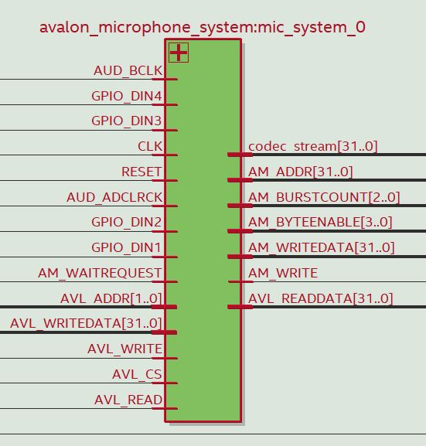
Avalon microphone system module
Core module of the system design
Takes in all microphone data lines
Acts as a master for writing to SDRAM
Acts as a slave to set up registers and signals for DMA finite state machine
Outputs channels to audio codec

Slide 6
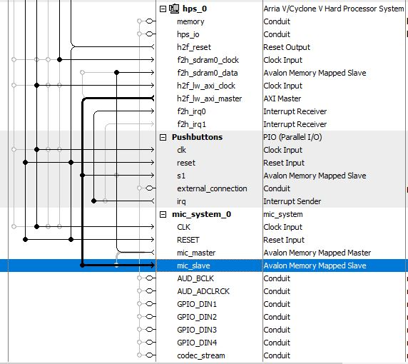
Memory mapped slave
Slave to the HPS data line
Slave sets up starting address
Number of samples
Sends start signal to master to begin writing to memory

Slide 7
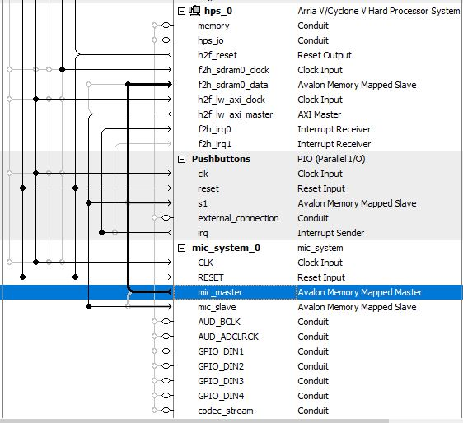
Memory mapped master
Master connects to FPGA to HPS SDRAM controller
Communicates via Avalon Memory Mapped Interface
Sends write, writedata, burstcount, byteenable, and address signals to sdram slave
Signals are determined in a finite state machine

Slide 8
Dma state machine (Master)
Sit in idle state until we get a signal from the slave to start
Enter waitdata state until we have a new sample ready
Once a sample is ready write each microphone sample to different addresses
Return back to waitdata state and wait for a new sample
Repeat until we have written the specified amount of samples from the slave.

Slide 9
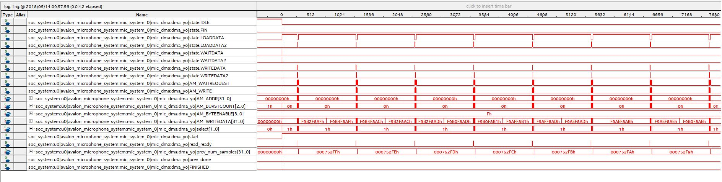

Slide 10
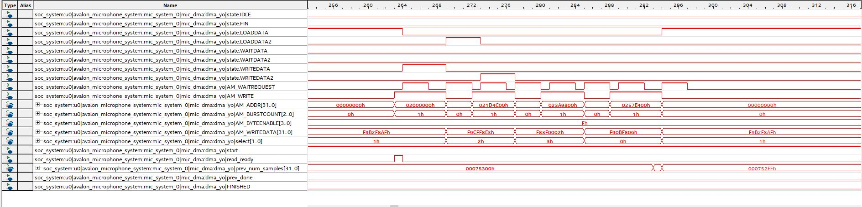

Slide 11
Arm-9 hardprocessor
Booted with Linux from SDCARD on Power up
Communicates to slaves through C program via memory map system call
Tells slave to start writing to memory
C program reads from physical memory (0x00000000 – 0x3FFFFFFF)
Stores data from physical memory as data files on SD card

Slide 12
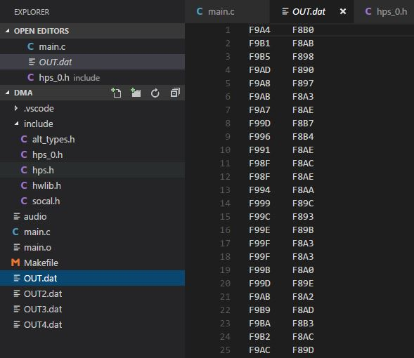

Slide 13
Data files
Raw data files are then converted from a python script and created as a wav file.
No synchronization error since we only write to memory when a new sample is ready! ☺

Slide 14
Future additions
Beamforming
More microphones
Circular buffers to overcome memory constraints

Slide 15
DEMo!

